Slide 1
Ordered Binary Decision Diagrams( OBDD)
Source: Randal E. Bryant
Carnegie Mellon University
http://www.cs.cmu.edu/~bryant

Slide 2
GRAPH MODELING

Slide 3
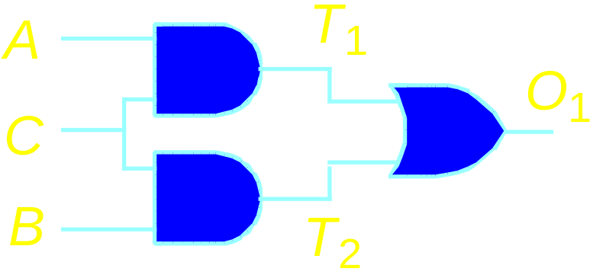
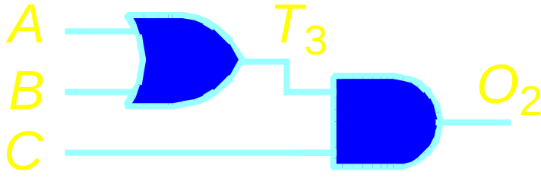
Example Analysis Task
Logic Circuit Comparison
  Do circuits compute identical function?
    Basic task of formal hardware verification
    Compare new design to “known good” design

Slide 4
Solution by Combinatorial Search
Satisfiability Formulation
  Search for input assignment giving different outputs
Branch & Bound
  Assign input(s)
  Propagate forced values
  Backtrack when cannot succeed
0
0
0
A
1
A
A
A
A
A
A
T
T
T
T
T
T
0
T
1
1
3
3
3
3
3
3
0
3
1
O
O
O
O
O
O
0
O
1
0
B
1
B
B
B
B
B
B
2
2
2
2
2
2
1
2
1
1
1
0
C
1
C
C
C
C
C
C
Diff
Diff
Diff
Diff
Diff
Diff
Diff
0
0
0
1
0
1
T
T
T
T
T
T
A
T
A
A
A
A
A
A
0
0
0
1
1
1
1
1
1
1
0
0
0
0
1
0
1
1
1
0
1
0
1
1
C
C
C
C
C
C
C
O
O
O
O
O
O
0
O
1
0
1
1
1
1
1
1
0
1
B
1
B
B
B
B
B
B
T
T
T
T
T
T
T
2
2
2
2
2
2
2
Challenge
  Must prove all assignments fail
    Co-NP complete problem
  Typically explore significant fraction of inputs
  Exponential time complexity
c
c
c
c
c
c
c
0
1
1
1
1
1
a
a
a
a
0
0
1
0
b
b
0
1

Slide 5
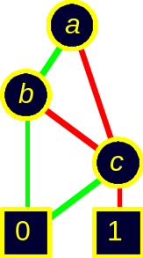
Alternate Approach
Generate Complete Representation of Circuit Function
  Compact, canonical form
  Functions equal if and only if representations identical
  Never enumerate explicit function values
  Exploit structure & regularity of circuit functions

Slide 6
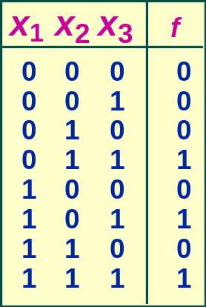
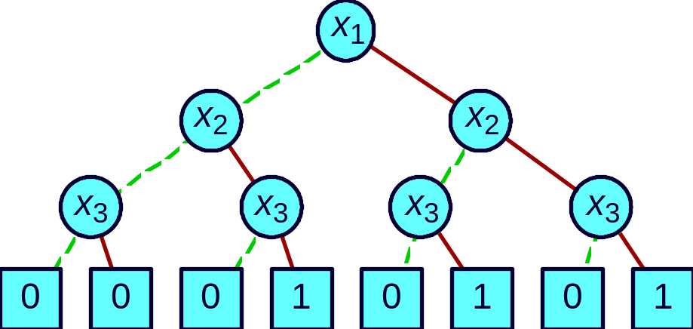
Decision Structures
Truth Table
Decision Tree
  Vertex represents decision
  Follow green (dashed) line for value 0
  Follow red (solid) line for value 1
  Function value determined by leaf value.

Slide 7
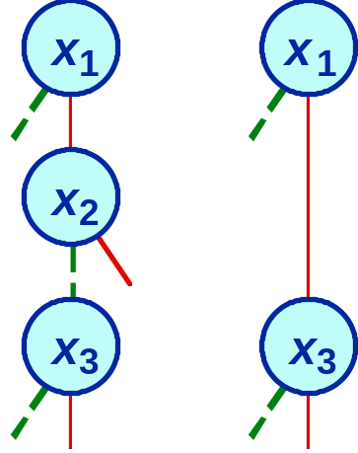
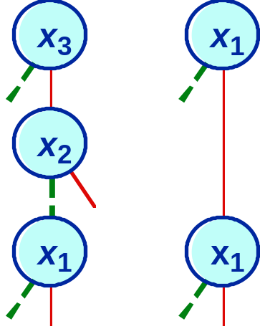
Variable Ordering
  Assign arbitrary total ordering to variables
    e.g., x₁ < x₂ < x₃
  Variables must appear in ascending order along all paths
OK
Not OK
Properties
  No conflicting variable assignments along path
  Simplifies manipulation

Slide 8
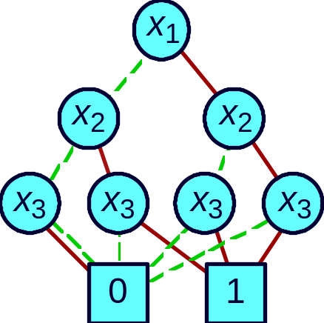
Reduction Rule #1
Merge equivalent leaves
a
a
a

Slide 9
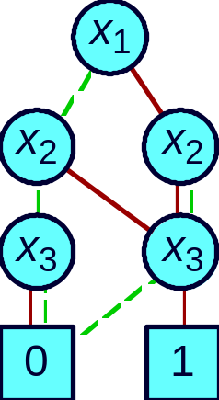
Reduction Rule #2
Merge isomorphic nodes
x
x
x
x
x
x
y
z
y
z
y
z

Slide 10
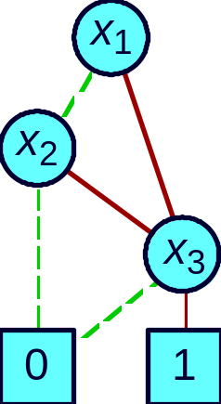
Reduction Rule #3
Eliminate Redundant Tests
x
y
y

Slide 11

Example OBDD
Initial Graph
Reduced Graph
Canonical representation of Boolean function
  For given variable ordering
  Two functions equivalent if and only if graphs isomorphic
    Can be tested in linear time
  Desirable property: simplest form is canonical.

Slide 12

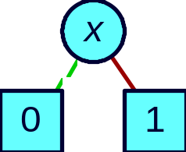

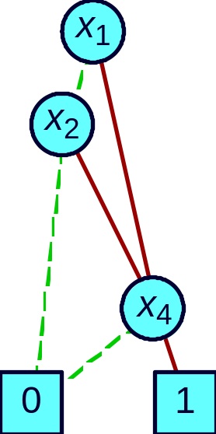
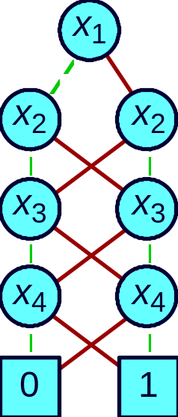
Example Functions
Constants
Variable
Unique unsatisfiable function
Treat variable
as function
Unique tautology
Typical Function
Odd Parity
(x₁ ∨ x₂ ) ∧ x₄
No vertex labeled x₃
  independent of x₃
Many subgraphs shared
Linear
representation

Slide 13
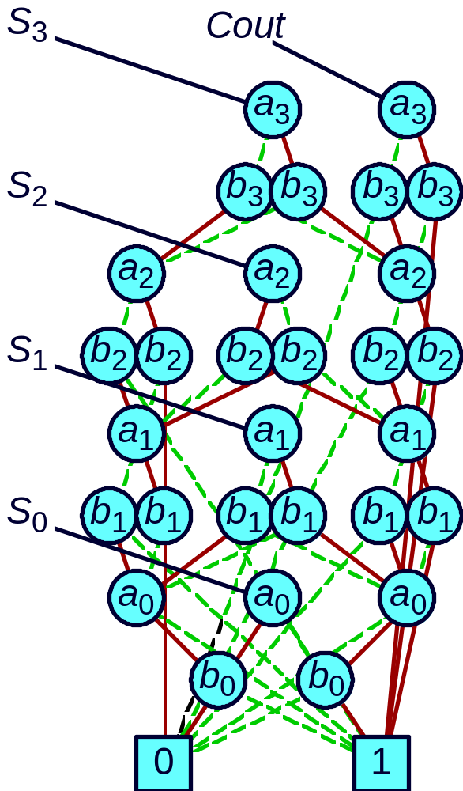
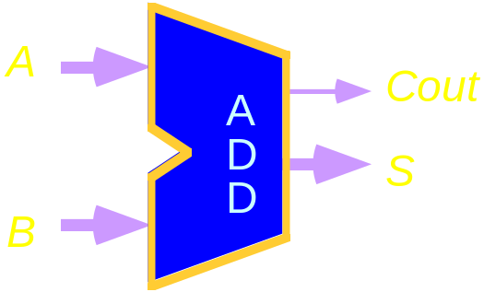
Representing Circuit Functions
Functions
  All outputs of 4-bit adder
  Functions of data inputs
Shared Representation
  Graph with multiple roots
  31 nodes for 4-bit adder
  571 nodes for 64-bit adder
  Linear growth

Slide 14

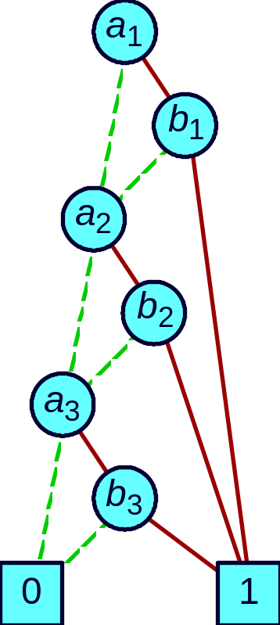
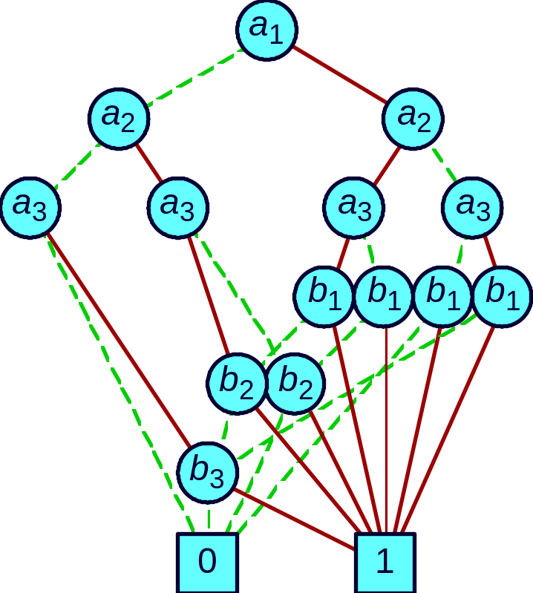
Effect of Variable Ordering
Good Ordering
Bad Ordering
Linear Growth
Exponential Growth

Slide 15
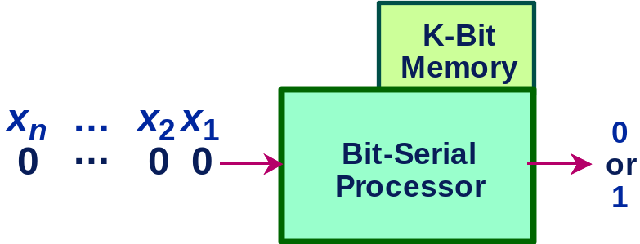
Bit Serial Computer Analogy
Operation
  Read inputs in sequence; produce 0 or 1 as function value.
  Store information about previous inputs to correctly deduce function value from remaining inputs.
Relation to OBDD Size
  Processor requires K bits of memory at step i.
  OBDD has ~ 2^{K} branches crossing level i.

Slide 16
Analysis of Ordering Examples
K = 2
K = n

Slide 17
Selecting Good Variable Ordering
Intractable Problem
  Even when problem represented as OBDD
    I.e., to find optimum improvement to current ordering
Application-Based Heuristics
  Exploit characteristics of application
  E.g., Ordering for functions of combinational circuit
    Traverse circuit graph depth-first from outputs to inputs
    Assign variables to primary inputs in order encountered

Slide 18
Dynamic Variable Reordering
  Richard Rudell, Synopsys
Periodically Attempt to Improve Ordering for All BDDs
  Part of garbage collection
  Move each variable through ordering to find its best location
Has Proved Very Successful
  Time consuming but effective
  Especially for sequential circuit analysis

Slide 19
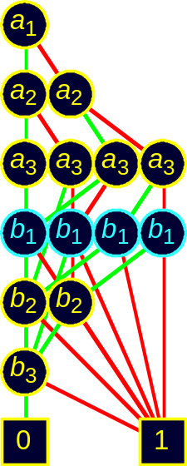
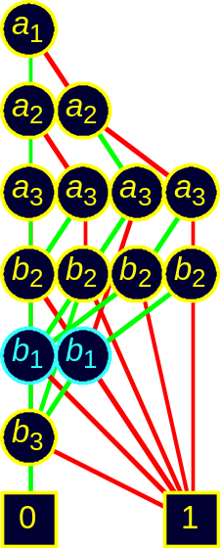
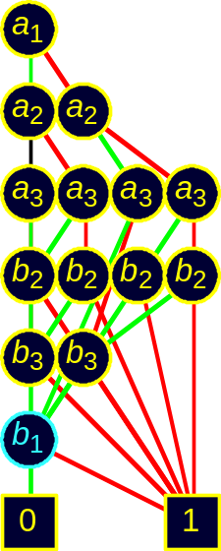
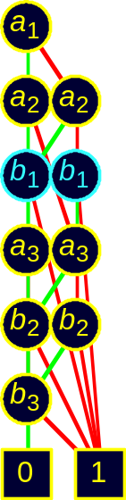
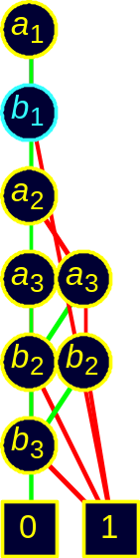
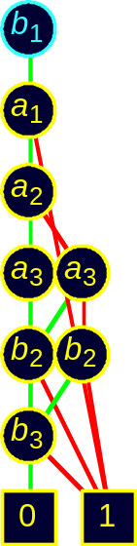
Dynamic Reordering By Sifting
  Choose candidate variable
  Try all positions in variable ordering
    Repeatedly swap with adjacent variable
  Move to best position found
Best
Choices
• • •

Slide 20
Swapping Adjacent Variables
Localized Effect
  Add / delete / alter only nodes labeled by swapping variables
  Do not change any incoming pointers
g
h
i
j
e
f
g
h
b
b
b
b
b
b
b
1
b
1
1
1
2
2
2
2
i
e
f
j
b
b
b
b
1
2
1
2

Slide 21
Sample Function Classes
Function Class Best Worst Ordering Sensitivity
ALU (Add/Sub) linear exponential High
Symmetric linear quadratic None
Multiplication exponential exponential Low
General Experience
  Many tasks have reasonable OBDD representations
  Algorithms remain practical for up to 100,000 node OBDDs
  Heuristic ordering methods generally satisfactory

Slide 22
Lower Bound for Multiplication
  Bryant, 1991
Integer Multiplier Circuit
  n-bit input words A and B
  2n-bit output word P
Boolean function
  Middle bit (n-1) of product
Complexity
  Exponential OBDD for all possible variable orderings
b_{n-1}
Mult_{n}
p_{2n-1}
•
•
•
•
•
•
Intractable
Function
b₀
p_{n}
a_{n-1}
p_{n-1}
•
•
•
•
•
•
a₀
p₀
Actual Numbers
  40,563,945 BDD nodes to represent all outputs of 16-bit multiplier
  Grows 2.86x per bit of word size

Slide 23
Symbolic Manipulation with OBDDs
Strategy
  Represent data as set of OBDDs
    Identical variable orderings
  Express solution method as sequence of symbolic operations
  Implement each operation by OBDD manipulation
Algorithmic Properties
  Arguments are OBDDs with identical variable orderings.
  Result is OBDD with same ordering.
  “Closure Property”
Contrast to Traditional Approaches
  Apply search algorithm directly to problem representation
    E.g., search for satisfying truth assignment to Boolean expression.

Slide 24
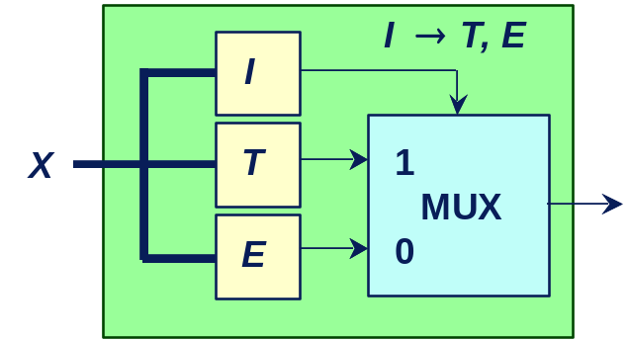
If-Then-Else Operation
Concept
  Basic technique for building OBDD from logic network or formula.
Arguments I, T, E
  Functions over variables X
  Represented as OBDDs
Result
  OBDD representing composite function
  (I ∧T) ∨ (¬I ∧ E)
Implementation
  Combination of depth-first traversal and dynamic programming.
  Worst case complexity product of argument graph sizes.

Slide 25
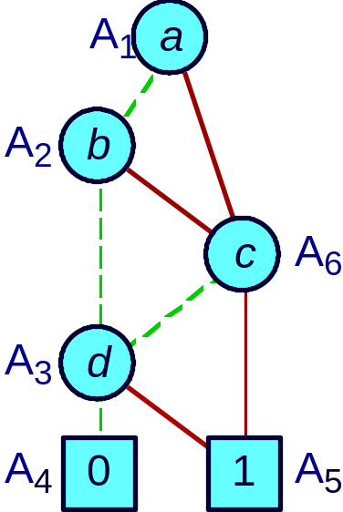

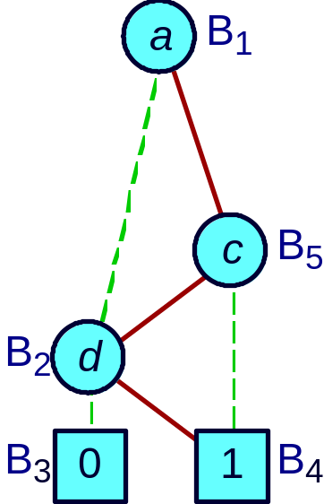
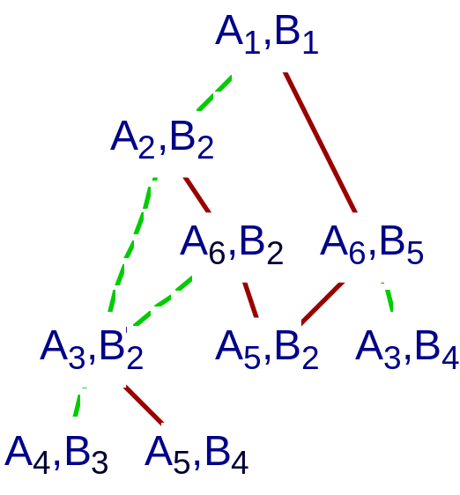
If-Then-Else Execution Example
Argument I
Argument T
Argument E
Recursive Calls
Optimizations
  Dynamic programming
  Early termination rules

Slide 26
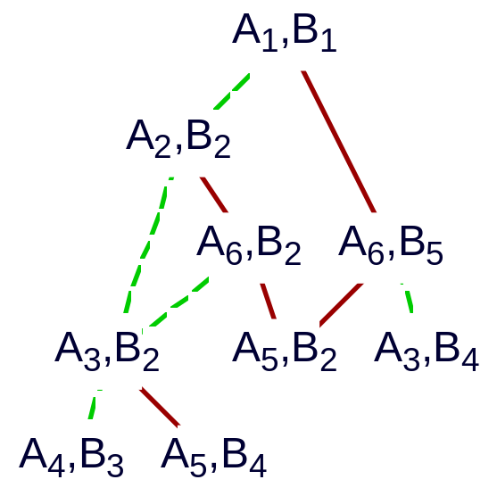
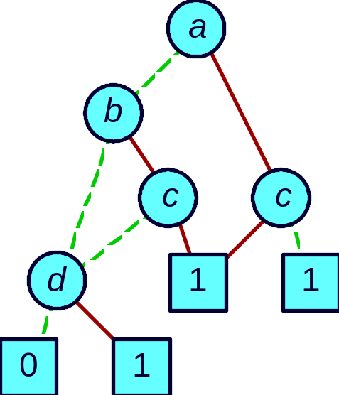
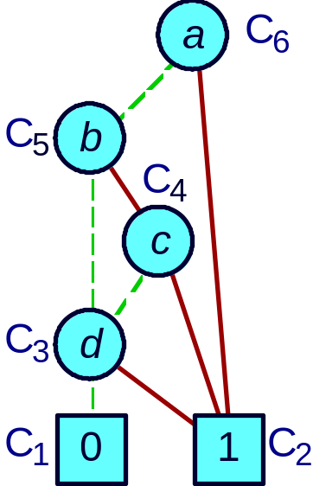
If-Then-Else Result Generation
Recursive Calls
Without Reduction
With Reduction
  Recursive calling structure implicitly defines unreduced BDD
  Apply reduction rules bottom-up as return from recursive calls
    Generates reduced graph

Slide 27
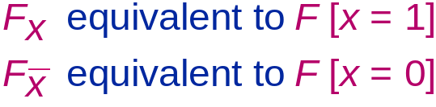
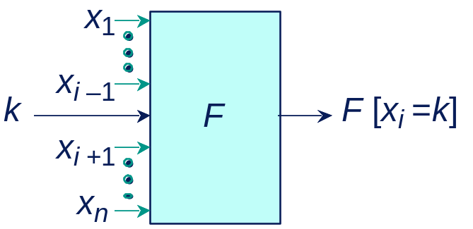
Restriction Operation
Concept
  Effect of setting function argument x_{i} to constant k (0 or 1).
  Also called Cofactor operation (UCB)
Implementation
  Depth-first traversal.
  Complexity near-linear in argument graph size

Slide 28
Derived Operations
  Express as combination of If-Then-Else and Restrict
  Preserve closure property
    Result is an OBDD with the right variable ordering
  Polynomial complexity
    Although can sometimes improve with special implementations

Slide 29
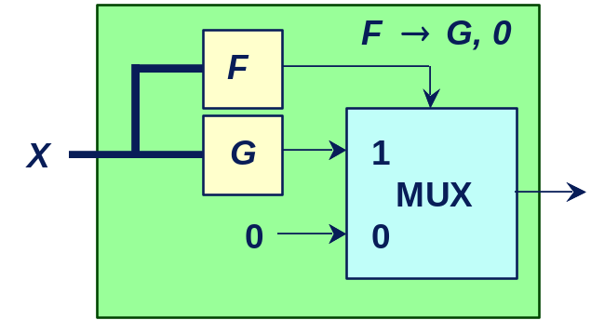
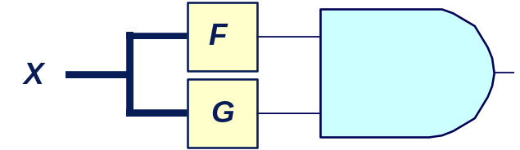
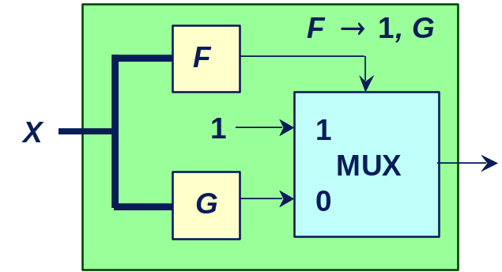
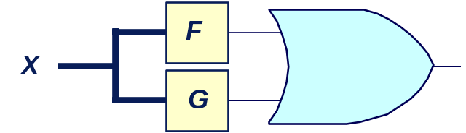
Derived Algebraic Operations
  Other operations can be expressed in terms of If-Then-Else
And(F, G)
If-Then-Else(F, G, 0)
If-Then-Else(F, 1, G)
Or(F, G)

Slide 30
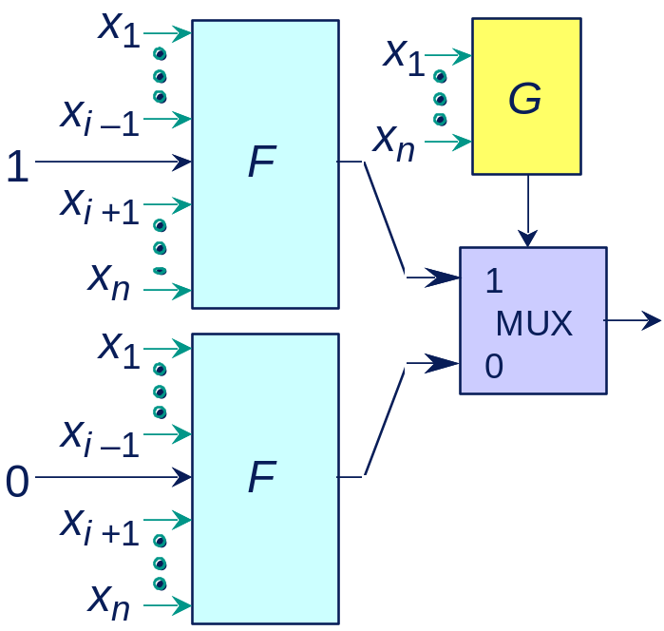
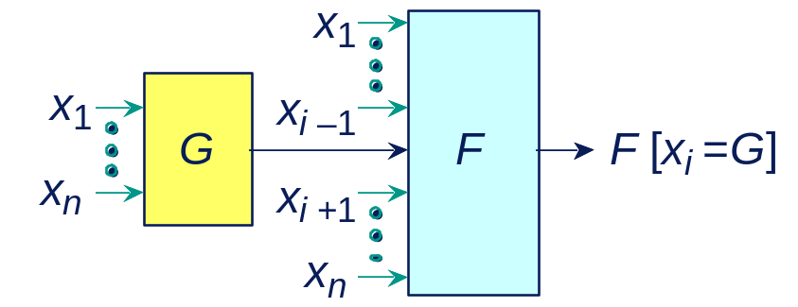
Functional Composition
  Create new function by composing functions F and G.
  Useful for composing hierarchical modules.

Slide 31
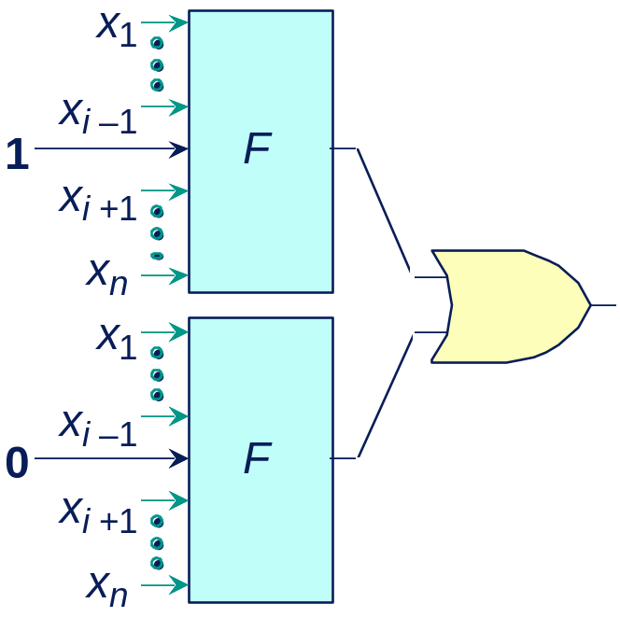
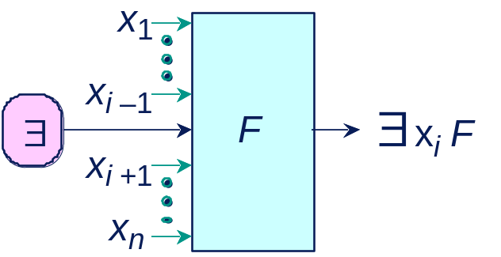
Variable Quantification
  Eliminate dependency on some argument through quantification
  Combine with AND for universal quantification.

Slide 32
Digital Applications of BDDs
Verification
  Combinational equivalence (UCB, Fujitsu, Synopsys, …)
  FSM equivalence (Bull, UCB, MCC, Siemens, Colorado, Torino, …)
  Symbolic Simulation (CMU, Utah)
  Symbolic Model Checking (CMU, Bull, Motorola, …)
Synthesis
  Don’t care set representation (UCB, Fujitsu, …)
  State minimization (UCB)
  Sum-of-Products minimization (UCB, Synopsys, NTT)
Test
  False path identification (TI)

Slide 33
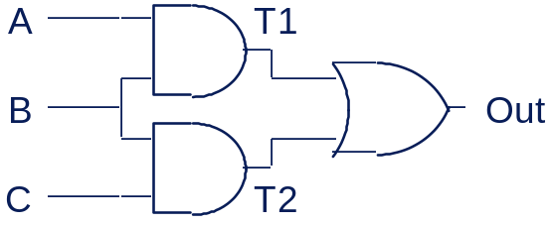
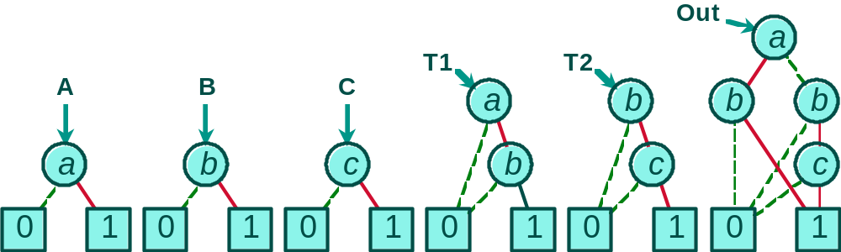
Generating OBDD from Network
Task: Represent output functions of gate network as OBDDs.
Network
Evaluation
A ← new_var ("a");
B← new_var ("b");
C ← new_var ("c");
T1 ← And (A, 0, B);
T2 ← And (B, C);
Out ← Or (T1, T2);
Resulting Graphs

Slide 34
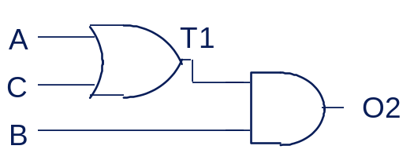
Checking Network Equivalence
  Task: Do two networks compute same Boolean function?
  Method: Compute OBDDs for both networks and compare
Alternate Network
Evaluation
T1 ← Or (A, C);
O2 ← And (T1, B);
if (O2 == Out)
then Equivalent
else Different
Resulting Graphs
O2
a
T1
A
B
C
a
b
b
a
b
c
c
c
0
1
0
1
0
1
0
1
0
1

Slide 35
Finite State System Analysis
Systems Represented as Finite State Machines
  Sequential circuits
  Communication protocols
  Synchronization programs
Analysis Tasks
  State reachability
  State machine comparison
  Temporal logic model checking
Traditional Methods Impractical for Large Machines
  Polynomial in number of states
  Number of states exponential in number of state variables.
  Example: single 32-bit register has 4,294,967,296 states!

Slide 36
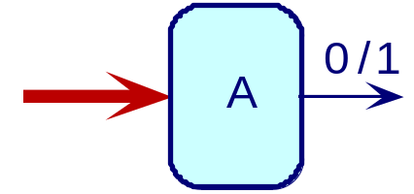
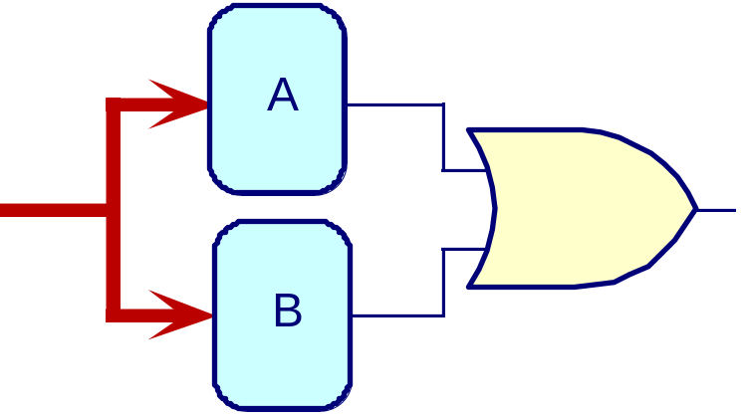
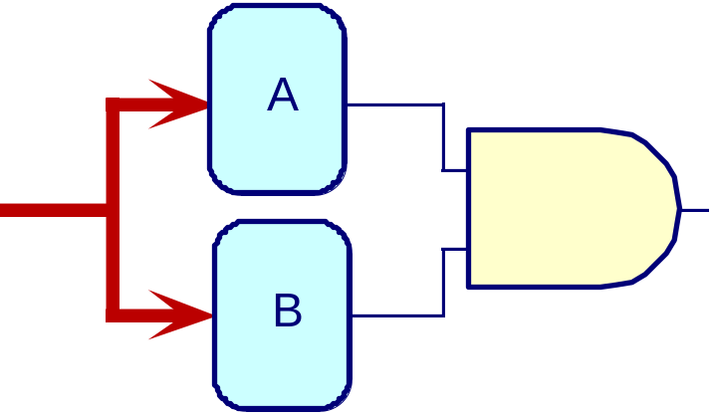
Characteristic Functions
Concept
  A ⊆ {0,1}^{n}
    Set of bit vectors of length n
  Represent set A as Boolean function A of n variables
    X ∈ A if and only if A(X ) = 1
Set Operations
Union
Intersection

Slide 37
Symbolic FSM Representation
Nondeterministic FSM
Symbolic Representation
n
1
00
01
n
2
o
1
,
o
2
encoded
o
1
old state
n
1
,
n
2
encoded
10
11
o
o
new state
2
2
0
1
  Represent set of transitions as function δ(Old, New)
    Yields 1 if can have transition from state Old to state New
  Represent as Boolean function
    Over variables encoding states

Slide 38
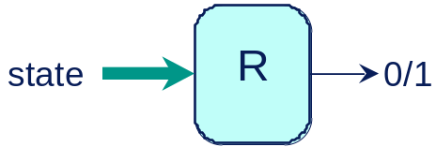
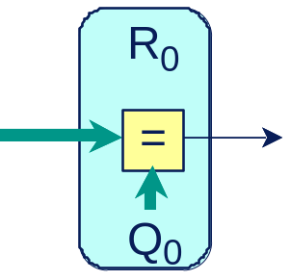
Reachability Analysis
Task
  Compute set of states reachable from initial state Q₀
  Represent as Boolean function R(S)
  Never enumerate states explicitly
Given
Compute
old state
δ
0/1
new state
Initial

Slide 39
Breadth-First Reachability Analysis
00
01
R₃
R₂
R₂
R₁
R₁
R₁
R₀
R₀
R₀
R₀
01
10
01
00
01
10
00
00
10
11
00
  R_{i} – set of states that can be reached in i transitions
  Reach fixed point when R_{n} = R_{n+1}
    Guaranteed since finite state

Slide 40
Iterative Computation
R
i
+1
R
i
∃
old
δ
new
R
i
  R_{i +1} – set of states that can be reached i +1 transitions
    Either in R_{i}
    or single transition away from some element of R_{i}

Slide 41
Example: Computing R₁ from R₀
n
n
1
1
R₀
n
n
2
2
00
o
1
1
0
0
o
2
o
2
∃ Old [R₀(Old) ∧ δ(Old, New)]
0
1
R₁
n
1
n
1
n
2
00
01
1
0
1
0
0

Slide 42
Symbolic FSM Analysis Example
  K. McMillan, E. Clarke (CMU) J. Schwalbe (Encore Computer)
Encore Gigamax Cache System
  Distributed memory multiprocessor
  Cache system to improve access time
  Complex hardware and synchronization protocol.
Verification
  Create “simplified” finite state model of system (10⁹ states!)
  Verify properties about set of reachable states
Bug Detected
  Sequence of 13 bus events leading to deadlock
  With random simulations, would require ≈2 years to generate failing case.
  In real system, would yield MTBF < 1 day.

Slide 43
What’s Good about OBDDs
Powerful Operations
  Creating, manipulating, testing
  Each step polynomial complexity
    Graceful degradation
  Maintain “closure” property
    Each operation produces form suitable for further operations
Generally Stay Small Enough
  Especially for digital circuit applications
  Given good choice of variable ordering
Weak Competition
  No other method comes close in overall strength
  Especially with quantification operations

Slide 44
What’s Not Good about OBDDs
Doesn’t Solve All Problems
  Can’t do much with multipliers
  Some problems just too big
  Weak for search problems
Must be Careful
  Choose good variable ordering
    Critical effect on efficiency
    Must have insights into problem characteristics
    Dynamic reordering most promising workaround
  Some operations too hard
    Must work around limitations

Slide 45
Relaxing Ordering Requirement
Challenge
  Ordering is key to important properties of OBDDs
    Canonical form
    Efficient algorithms for operating on functions
  Some classes of functions have no good BDD orderings
    Graphs grow exponentially in all cases
  Would like to relax requirement
    but still preserve (most of) the algorithmic properties
Free Ordering
  Gergov & Meinel, Sieling & Wegener
  Slight relaxation of ordering requirement

Slide 46
Intractable OBDD Function Example
Rotator
  Circular shift of data
  Shift amount set by control
Control
Data
Rotate
0
Rotations
Difficult Function
  Rotate & compare
1
C
2
3
A
Rotate
=
B

Slide 47
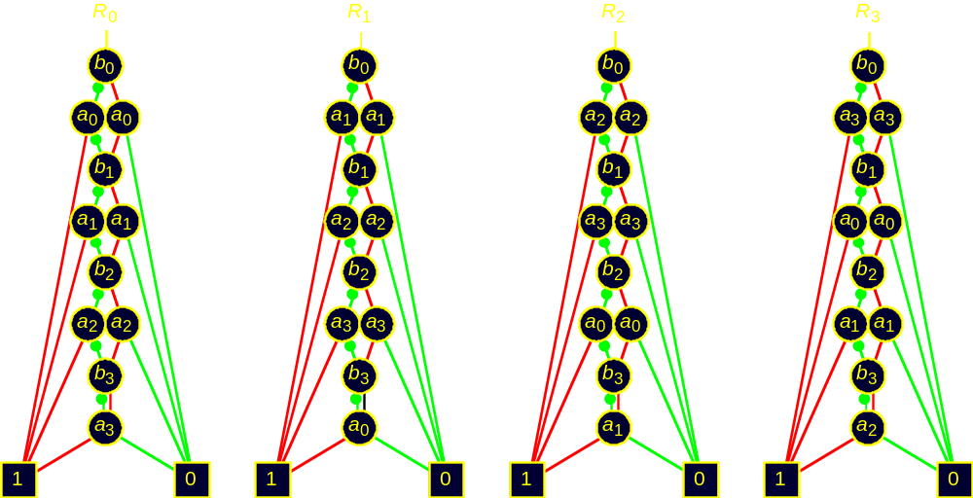
OBDDs for Specific Rotations
  Can choose good ordering for any fixed rotation

Slide 48


Forcing Single Ordering
  Good ordering for one rotation terrible for another
  For any ordering, some rotation will have exponential OBDD

Slide 49


Free BDDs
Rules
  Variables may appear in any order
  Only allowed to test variable once along any path
OK
Not OK
Extraneous
path

Slide 50

Rotation Function Example
Advantage
  Can select separate ordering for each rotation
  Good when different settings of control call for different orderings of data variables
Still Has Limitations
  Representing output functions of multiplier
    Exponential for all possible Free BDDs
    Ponzio, ‘95

Slide 51
Making Free BDDs Canonical
Modified Ordering Requirement
  For any given variable assignment, variables must occur in fixed order
  But can vary from one assignment to another
Algorithmic Properties Similar to OBDDs
  Reduce to canonical form
  Apply Boolean operation to functions
  Test for equivalence, satisfiability, etc.
Some Operations Harder
  Variable quantification and composition
  But can restrict relevant variables to be totally ordered

Slide 52

Representing Free Ordering
Ordering Graph
  Encodes assignment-dependent variable ordering
Similar to BDD
  Follow path according to assignment
OBDD is Special Case
  Linear chain
Ordering Requirement
  All functions must be compatible with single ordering graph

Slide 53
Practical Aspects of Free BDDs
Make Sense in Some Application Domain
  Usage of bits varies with context
  E.g., instruction set encodings
Must Determine Good Ordering Graph
  Some success with heuristic methods
  Ideally should be done dynamically
    Overwhelming degrees of freedom
Need to Demonstrate Utility on Real-Life Examples

